Slide 1




SMT.TANUBEN & DR MANUBHAI TRIVEDI COLLEGE OF INFORMATION SCIENCE
AFFILIATED TO
VEER NARMAD SOUTH GUJARAT UNIVERSITY SURAT
YEAR :2023-24
PROJECT REPORT
“E-Notes Management System”
Prof | Nikisha Mithaiwala
Presented By-Bendre Pratiksha(1893),Uma Chaudhary(1861),Prasad Anjali(1938)

Slide 2
PERSONAL PROFILE
Details | Member 1
ExamNo: | 1893
Name | Bendre pratiksha
ContactNo | 9574831868
Email | bendrepratiksha747@gmail.com
E-Notes Management System

Slide 3
PERSONAL PROFILE
Details | Member 2
ExamNo: | 1938
Name | Prasad Anjali
ContactNo | 8140455917
Email | anjalirprasad33gmail.com
E-Notes Management System

Slide 4
PERSONAL PROFILE
Details | Member 3
ExamNo: | 1861
Name | Uma Chaudhary
ContactNo | 9316025773
Email | chaudhary.uma10@gmail.com
E-Notes Management System

Slide 5
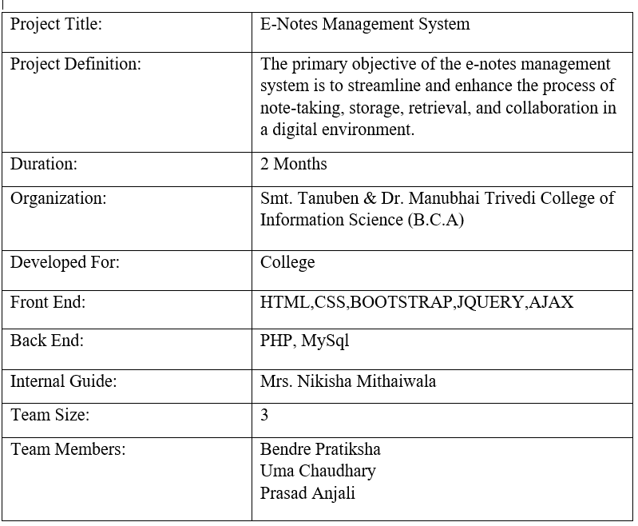
PROJECT PROFILE
E-Notes Management System

Slide 6




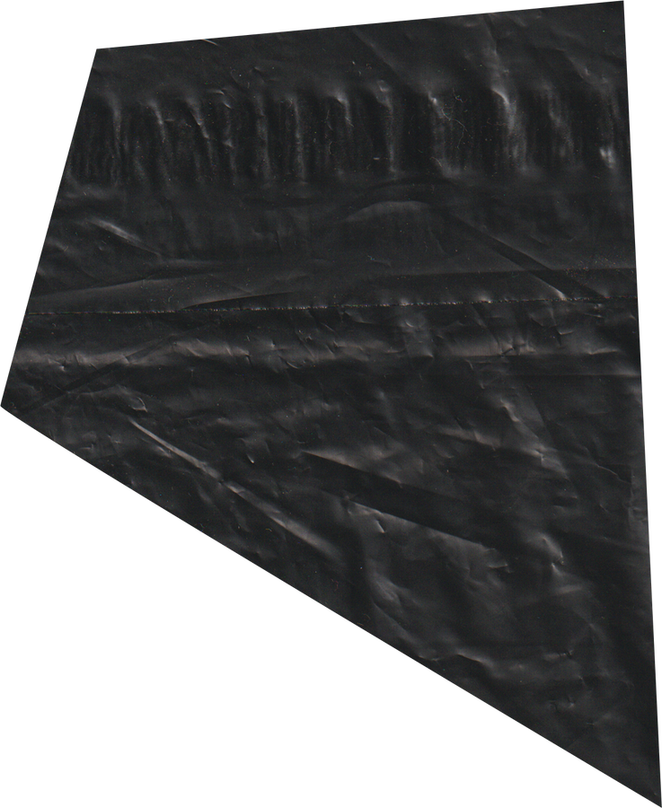

BORCELLE
E-NOTES
2024

Slide 7
POINTS TO BE COVERED...
1
OBJECTIVE OF SYSTEM
6
TESTING REPORT
2
PROJECT CATEGORY
7
LIMITATION OF PROPOSED SYSTEM
3
TOOLS & ENVIRONMENT
8
FUTURE ENCHANCEMENT OF SYSTEM
4
ANALYSIS REPORT
9
JUSTIFICATION OF MIS
5
DESIGN REPORT
10
REFERENCES

Slide 8
OBJECTIVE
• Streamlines and enhances note-taking, storage, retrieval, and collaboration in digital environment.
• Provides user-friendly, centralized platform for creating, organizing, and accessing electronic notes.
• Aim to revolutionize digital note-taking, improving efficiency and knowledge management.
• Key goals include improving information accessibility, ensuring data security, and facilitating seamless collaboration.
E-Notes Management System
1

Slide 9
PROJECT CATEGORY
E-Notes Management System is based on Web Technology
The E-Notes Management System is designed to provide a comprehensive digital solution for efficient note-taking, organization, and collaboration
The primary goal is to transition from traditional paper-based note-taking methods to a streamlined electronic system, promoting accessibility, security, and collaboration.
E-Notes Management System
2

Slide 10
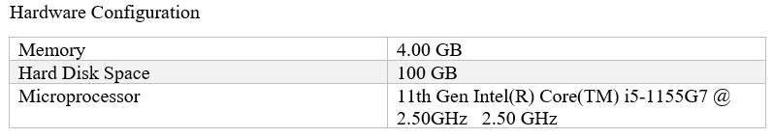
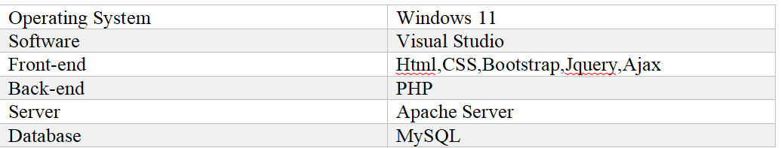
TOOLS & TECHNOLOGY
Developer Site
E-Notes Management System
3

Slide 11
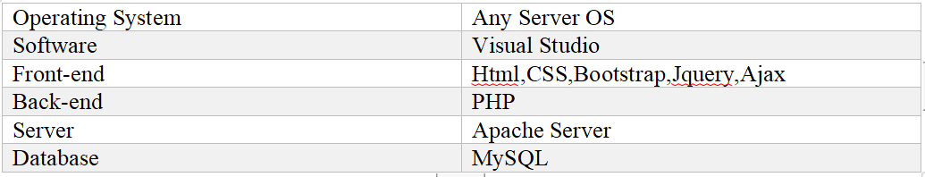
TOOLS & TECHNOLOGY
Server Site
E-Notes Management System
4

Slide 12


TOOLS & TECHNOLOGY
Client Site
Any web browser like internet Explorer,google chrome and Mozilla Firefox etc
E-Notes Management System
4

Slide 13
In the existing system the students need to manage notetaking can be viewed as recording information by hand on paper using pen and paper method(P&P)
Make Time for Note taking Activities
You can’t write down every word
Pay Attention: it’s very easy to start daydreaming during lectures and miss an important point
ANALYSIS REPORT
Current System
E-Notes Management System
5

Slide 14
fvv
ANALYSIS REPORT
Drawback Of Current System
Physical notes are often confined to the location of their creation, making them difficult to access if lost or forgotten.
Maintaining a systematic structure becomes more complex with increasing note volume.
Physical notebooks can be lost, damaged, or destroyed, putting important information at risk.
Sharing handwritten notes is less convenient than digital alternatives, making collaborative work more challenging.
Manual note-taking struggles with integrating multimedia elements.
Handwritten notes may be more susceptible to unauthorized access, loss, or theft.
E-Notes Management System
6

Slide 15
fvv
ANALYSIS REPORT
User should be able to Login Website based on their role as a Faculty or Student
Faculty can upload Notes as pdf,doc,videos
Faculty can view Notes and Download notes
Faculty can upload Assignement
Faculty can view Assignment
Faculty can view Assignment Completion by Student
Faculty can Approve and Reject Assignement Completion
Faculty can have functionality like comment system
Requirement specification
E-Notes Management System
7

Slide 16
fvv
ANALYSIS REPORT
Requirement specification
Faculty can view student based on their status like online or offline
Faculty should be able to logout from the website
Student should be able to login in website
Student can view Notes and Download notes
Student can upload Assignment
Student view classmates based on their status like online or offline
Student can have functionality like comment system
Student should be able to logout
Admin should be able to login
Admin should be able to manage everything like subject, Student, Faculty
5
E-Notes Management System
8

Slide 17
fvv
ANALYSIS REPORT
Proposed System
The proposal for an E-Notes Management System. This system aims to streamline the organization and sharing of educational notes. Here are some key aspects of the proposed system:
The proposed system aims to overcome these limitations and provide an improved note-sharing experience
It provides a safe environment for sharing educational resources.
Efficient distribution of notes saves time for both teachers and students
The primary goal is to create a user-friendly platform where recognized teachers can upload their notes.
Students studying specific subjects can then easily access and download these notes.
5
5
E-Notes Management System
9

Slide 18
fvv
ANALYSIS REPORT
Roles of Users
Guest User
View Web application
Content Page
Faculty
Can Login
Can Upload Notes (pdf,video,docs)
Can Allocate Assignments(pdf)
Can Allow or Reject Assignment
Can view Students By Search
Can View Student Status(online/offline)
8
8
E-Notes Management System
10

Slide 19
fvv
ANALYSIS REPORT
Roles of Users
Student
Can Login
View Notes
Upload completed Assignement(pdf)
Can View Classmates Status(online/offline)
Admin
Manage Faculty
Manage Student
View Contact us
Manage Subject
E-Notes Management System
11

Slide 20
fvv
ANALYSIS REPORT
Advantage of Proposed System
Accessibility Anytime, Anywhere
Centralized Platform
User-Friendly Interface
Real-Time Collaboration
E-Notes Management System
12

Slide 21
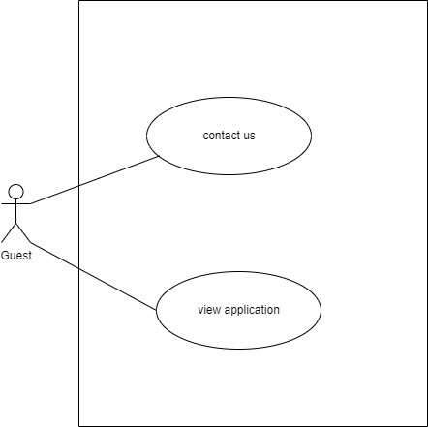
UML
fvv
USECASE
Guest User
E-Notes Management System
13

Slide 22
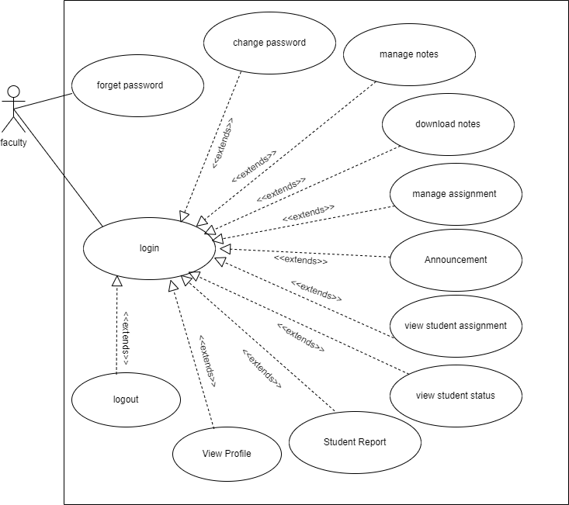
UML
fvv
USECASE
Faculty
E-Notes Management System
14

Slide 23
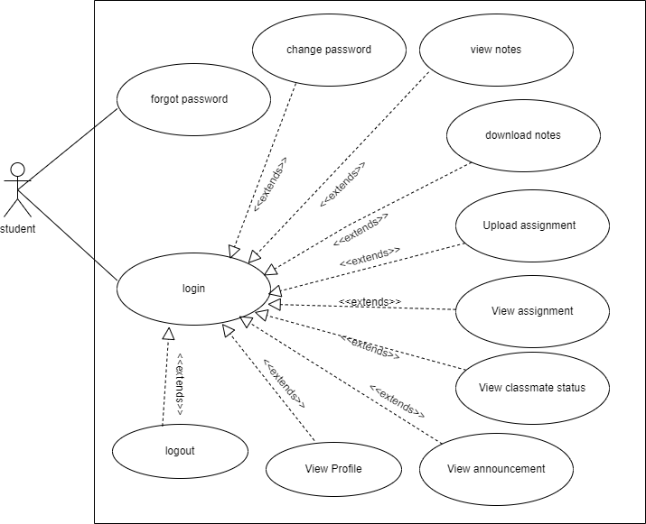
UML
fvv
USECASE
Student
E-Notes Management System
15

Slide 24
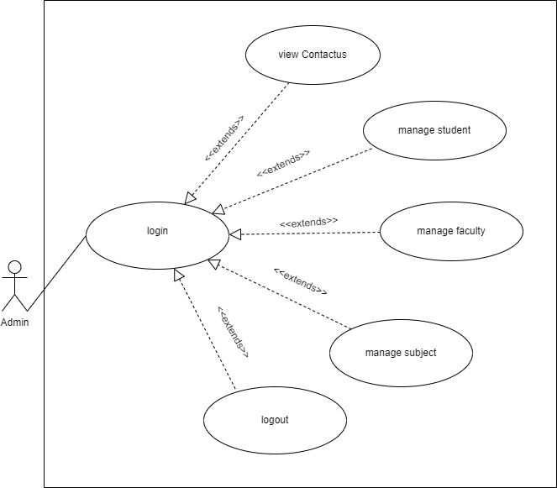
UML
fvv
USECASE
Admin
E-Notes Management System
16

Slide 25
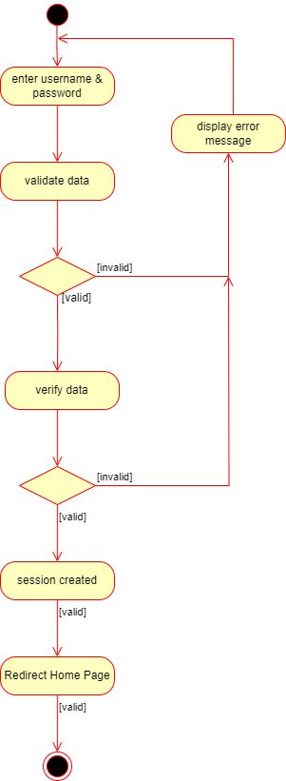

UML
Activity Diagram
Login
Change Password
E-Notes Management System
17

Slide 26
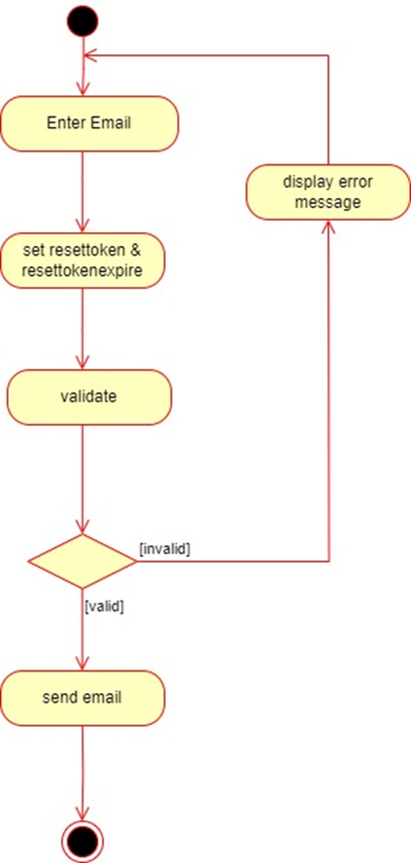

UML
Activity Diagram
Forget Password
Email verify
E-Notes Management System
18

Slide 27
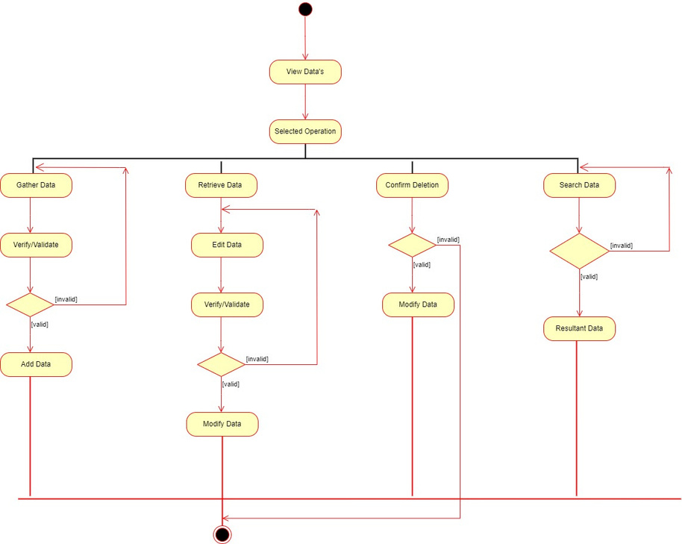
UML
Activity Diagram
E-Notes Management System
19

Slide 28
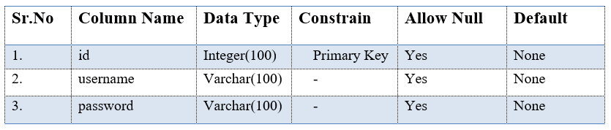
TABLE
tbladmin:
E-Notes Management System
20

Slide 29
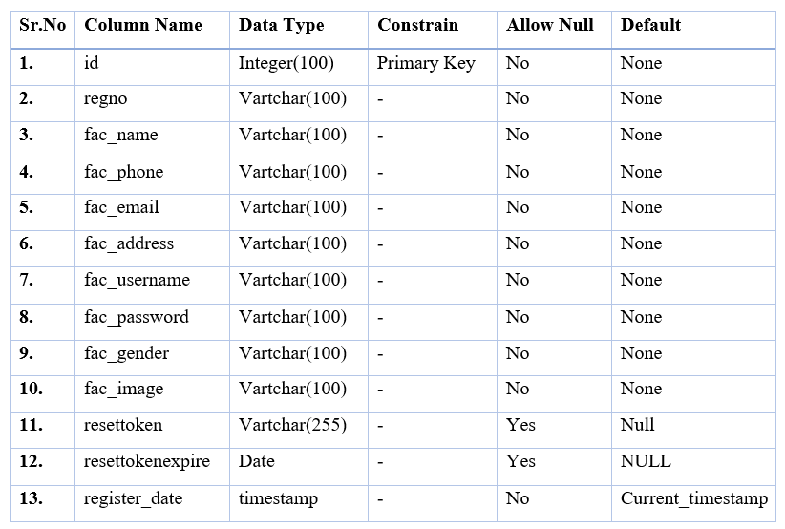
TABLE
tblfaculty:
E-Notes Management System
21

Slide 30
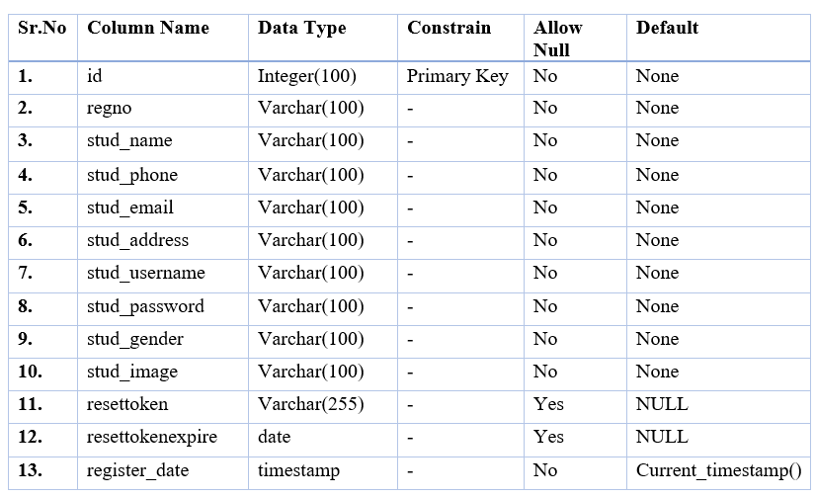
TABLE
tblstudent:
E-Notes Management System
22

Slide 31
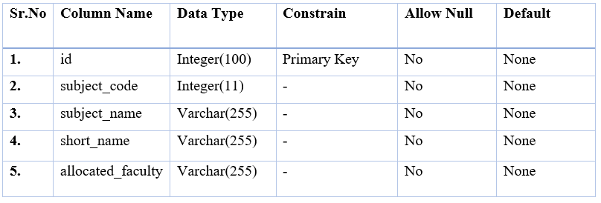
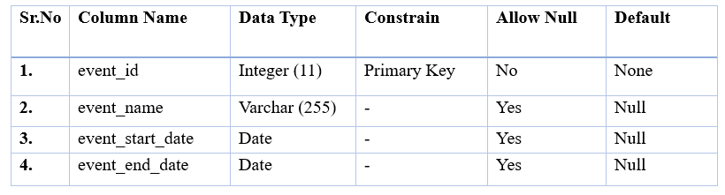
TABLE
tblsubject :
: tblevent
E-Notes Management System
23

Slide 32
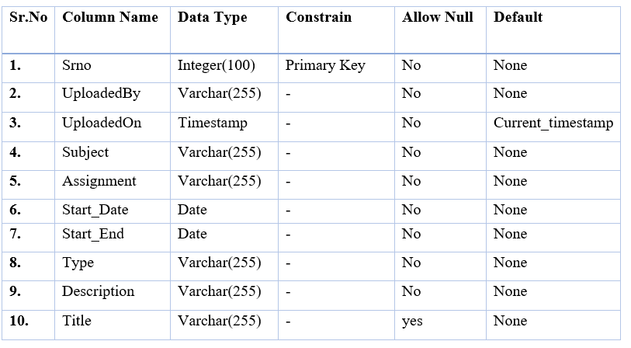
TABLE
tblassignment:
E-Notes Management System
24

Slide 33
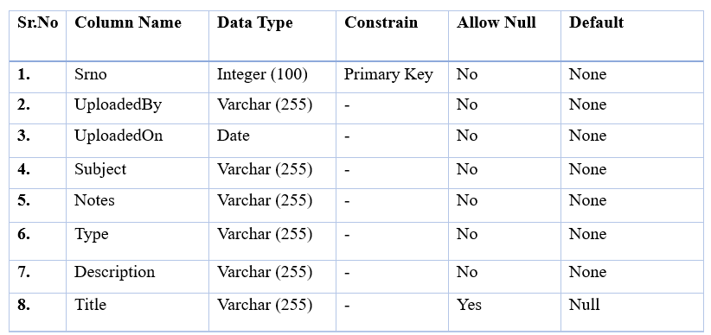
TABLE
tblnotes:
E-Notes Management System
25

Slide 34
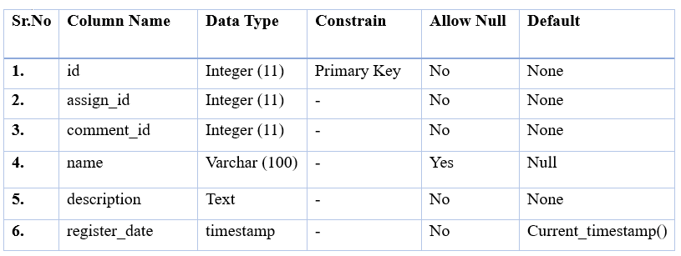
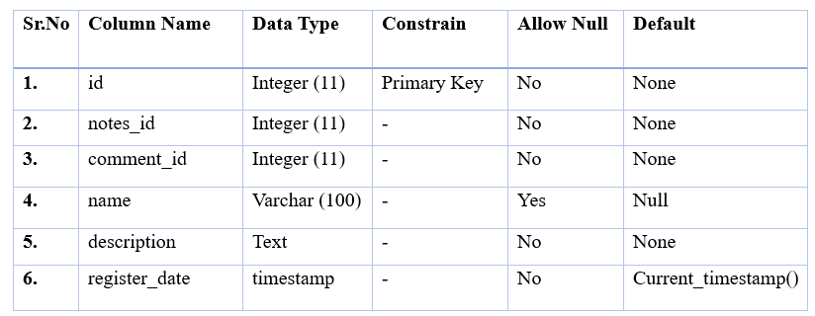
TABLE
comments:
:comments_notes
E-Notes Management System
26

Slide 35
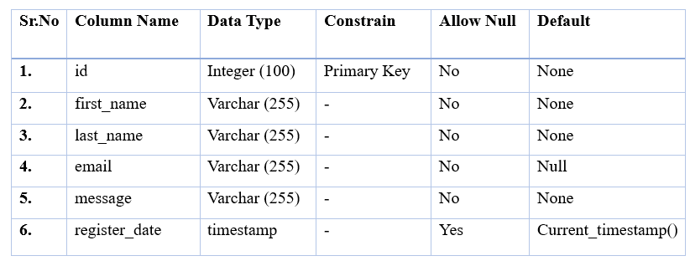
TABLE
tblcontact:
E-Notes Management System
27

Slide 36
DESIGN REPORT
Security Issues:
User authentication is performed so that no authorized user can access the system.
Email ID and Password are authorized from the database.
System operations are performed as per the type of users using the systems.
User cannot change his/her password without entering the old password.
Session is maintained for user.
Only Logged in user can access notes.
Websites uses encryption and decryption method to store user password.
E-Notes Management System
28

Slide 37
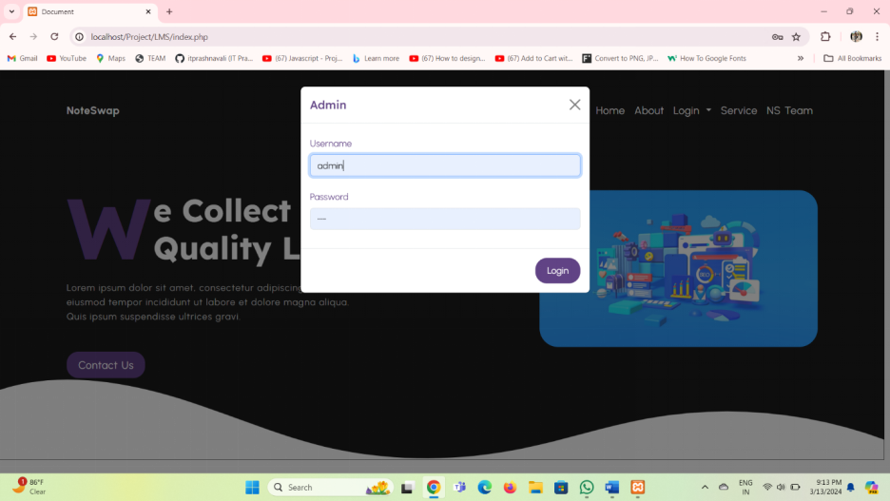
DESIGN REPORT
Input Screen Layout:
E-Notes Management System
29

Slide 38
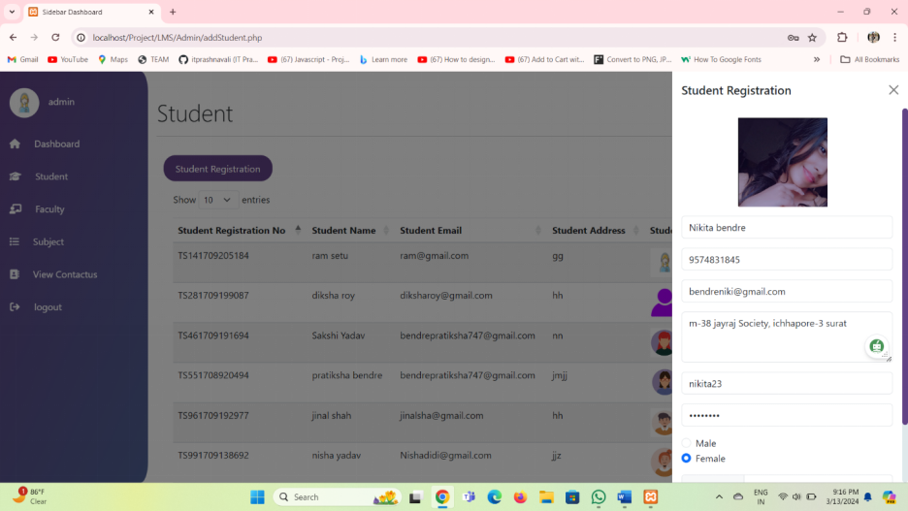
DESIGN REPORT
E-Notes Management System
30

Slide 39
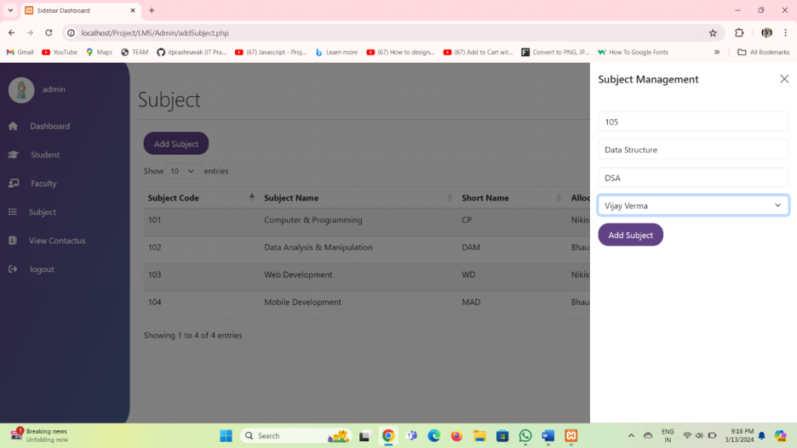
DESIGN REPORT
E-Notes Management System
31

Slide 40
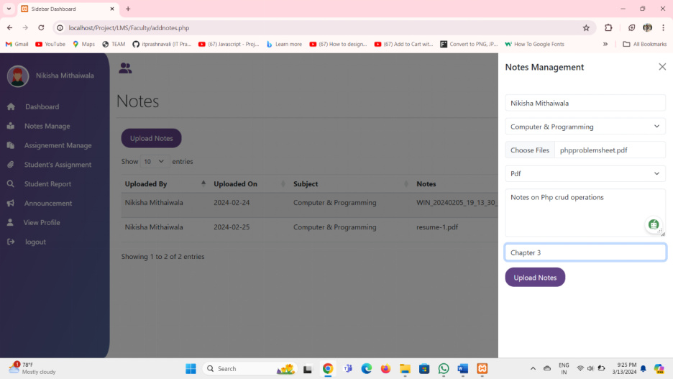
DESIGN REPORT
E-Notes Management System
32

Slide 41
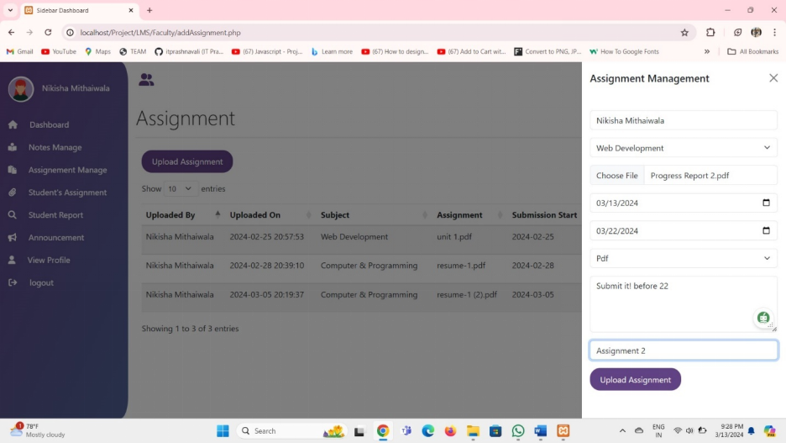
DESIGN REPORT
E-Notes Management System
33

Slide 42
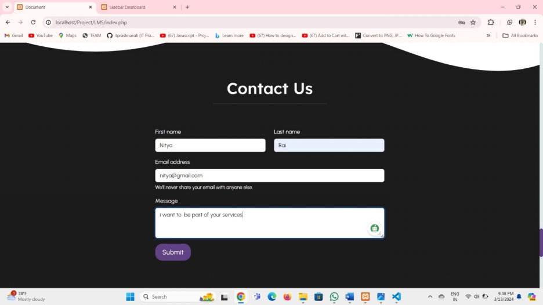
DESIGN REPORT
E-Notes Management System
34

Slide 43
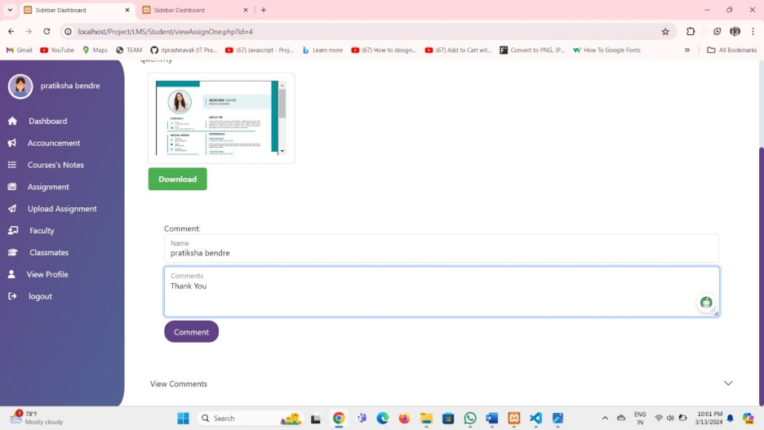
DESIGN REPORT
E-Notes Management System
35

Slide 44
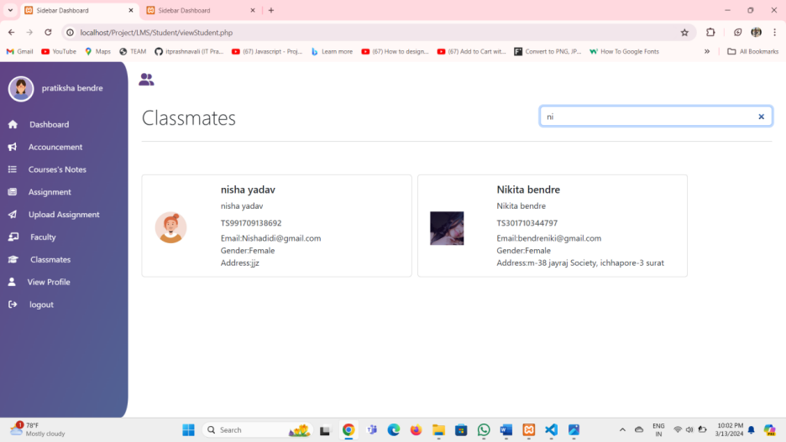
DESIGN REPORT
E-Notes Management System
36

Slide 45
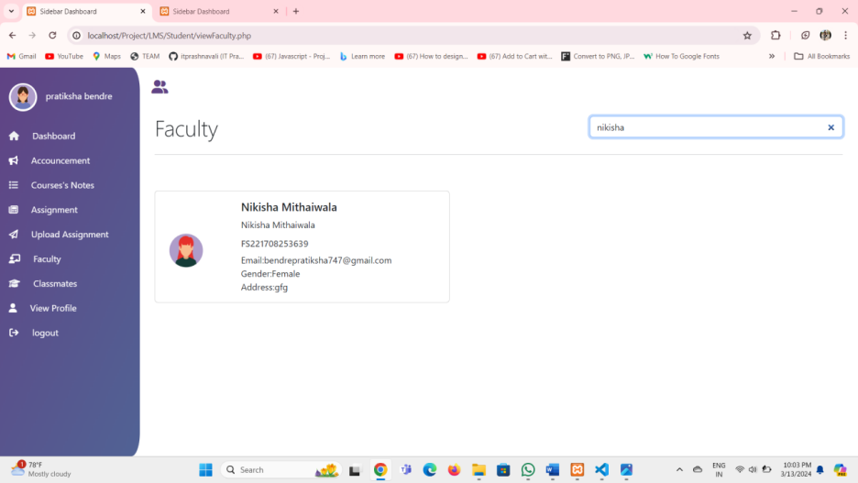
DESIGN REPORT
Output Screen Layout:
Output Screen Layout:
E-Notes Management System
37

Slide 46
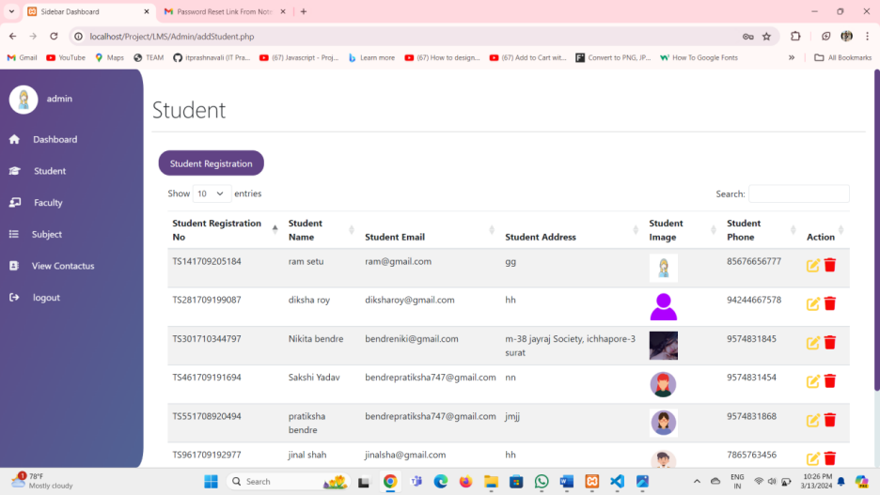
DESIGN REPORT
E-Notes Management System
38

Slide 47
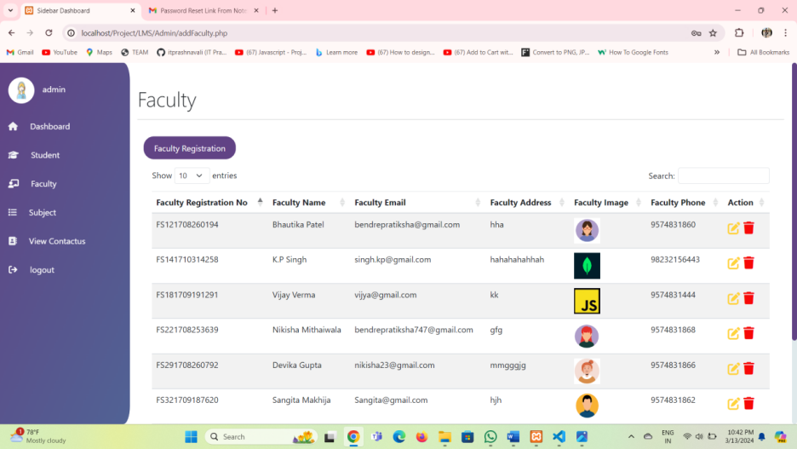
DESIGN REPORT
E-Notes Management System
39

Slide 48
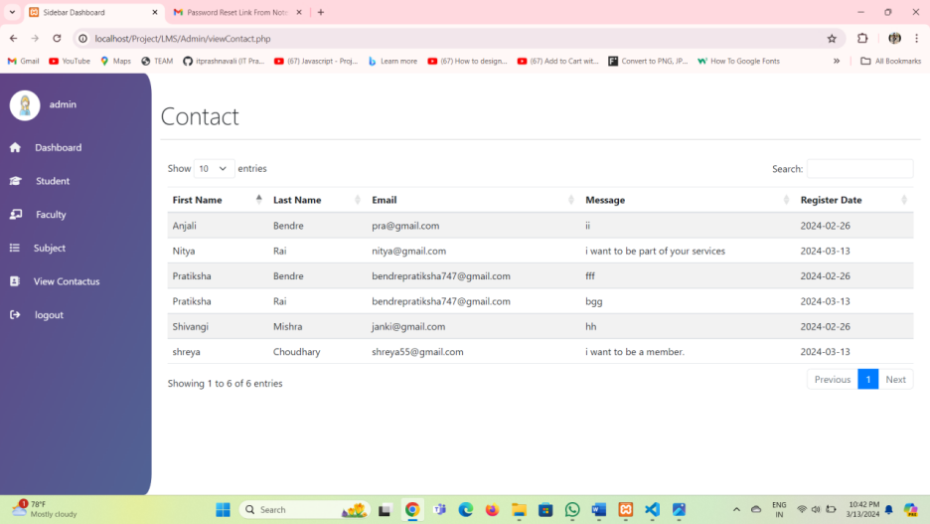
DESIGN REPORT
E-Notes Management System
40

Slide 49
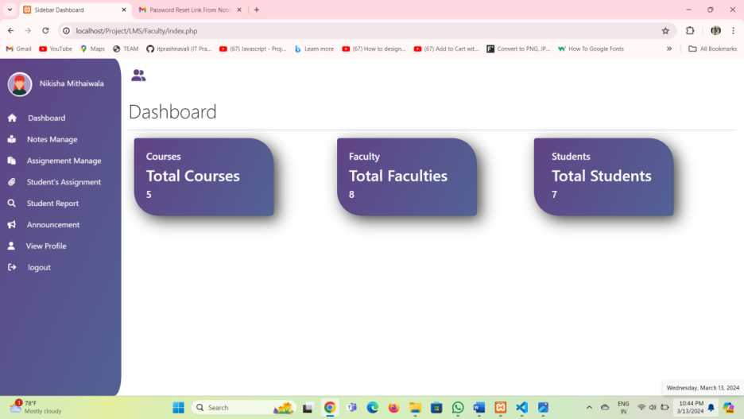
DESIGN REPORT
E-Notes Management System
41

Slide 50
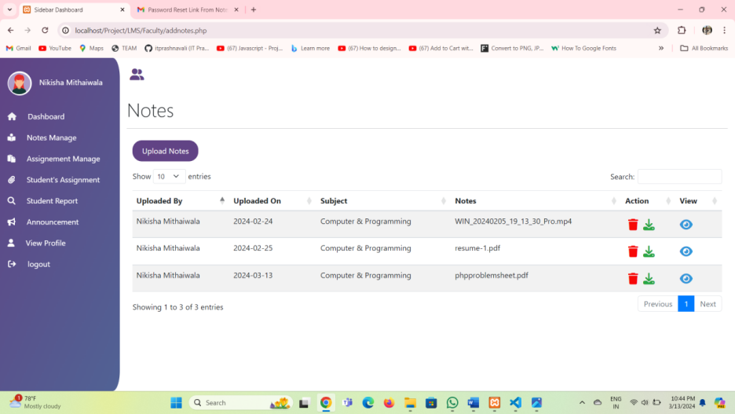
DESIGN REPORT
E-Notes Management System
42

Slide 51
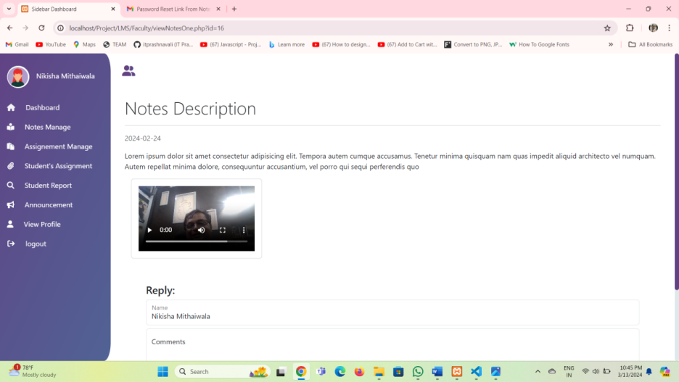
DESIGN REPORT
E-Notes Management System
43

Slide 52
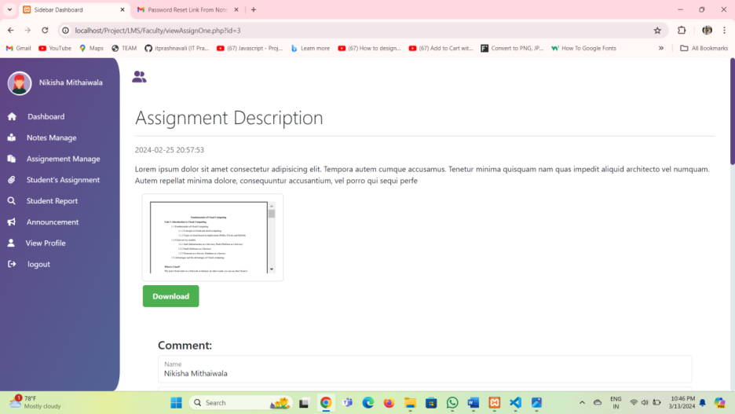
DESIGN REPORT
E-Notes Management System
44

Slide 53
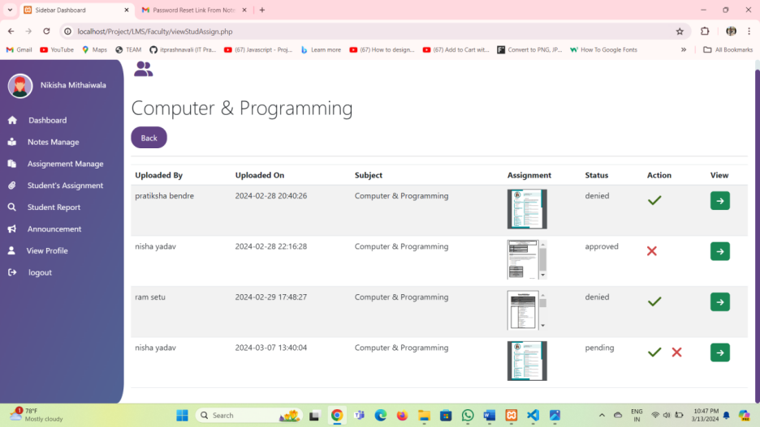
DESIGN REPORT
E-Notes Management System
45

Slide 54
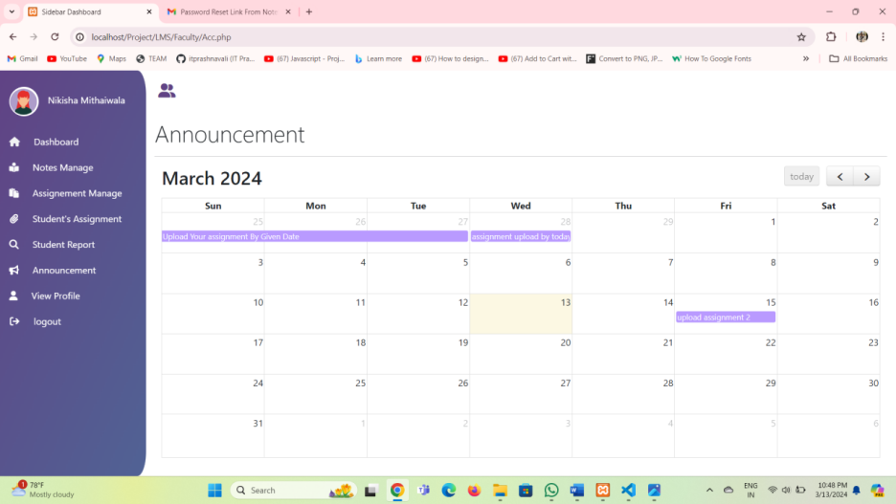
DESIGN REPORT
E-Notes Management System
46

Slide 55
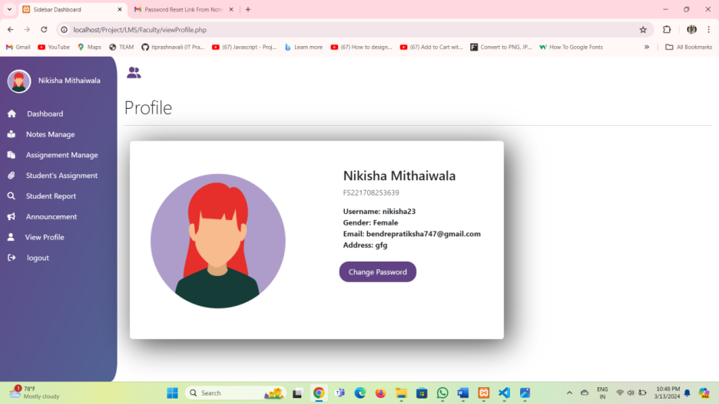
DESIGN REPORT
E-Notes Management System
47

Slide 56
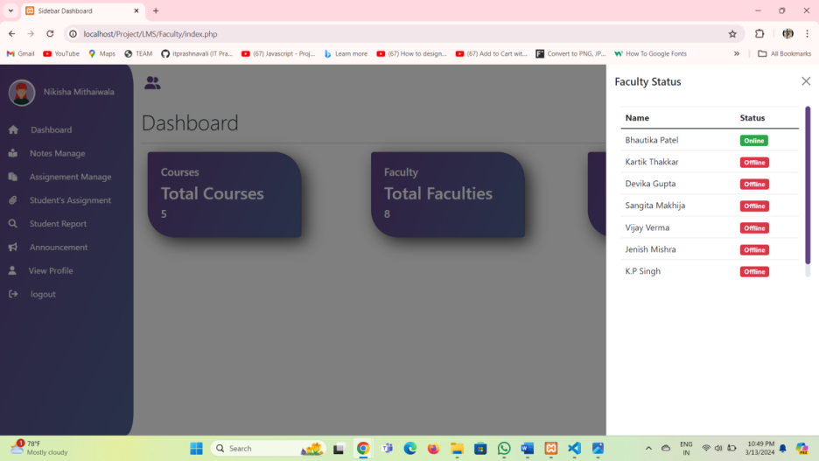
DESIGN REPORT
E-Notes Management System
47

Slide 57
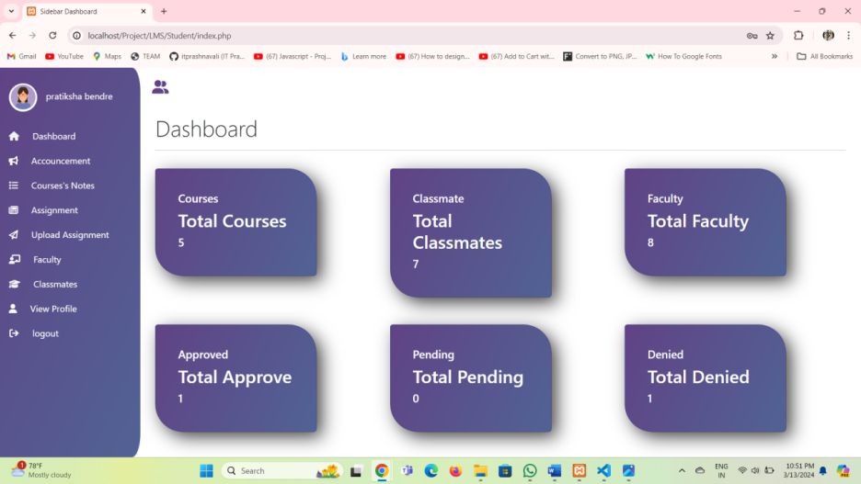
DESIGN REPORT
E-Notes Management System
48

Slide 58
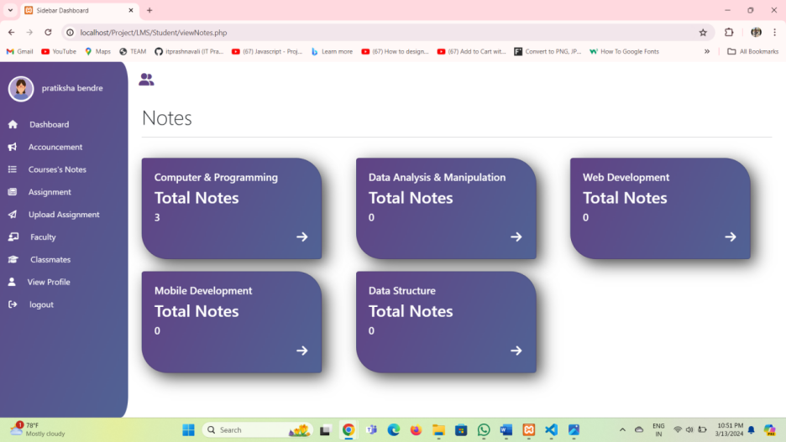
DESIGN REPORT
E-Notes Management System
49

Slide 59
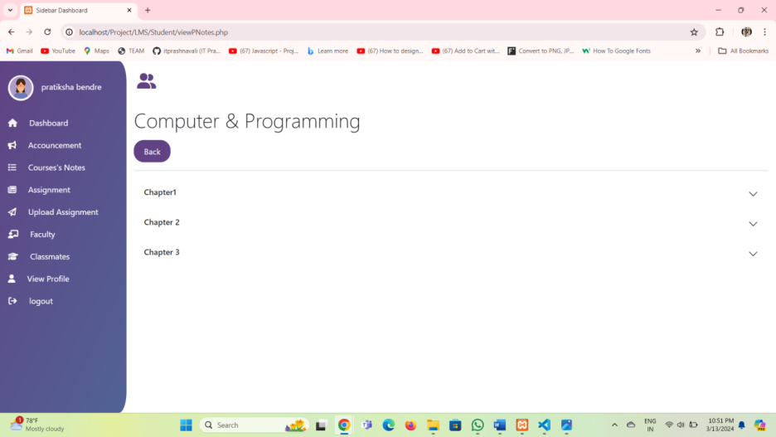
DESIGN REPORT
E-Notes Management System
50

Slide 60
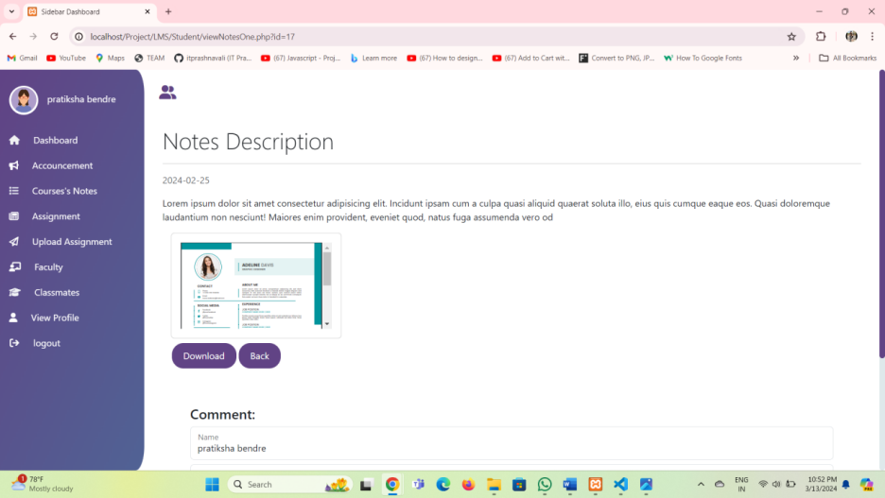
DESIGN REPORT
E-Notes Management System
52

Slide 61
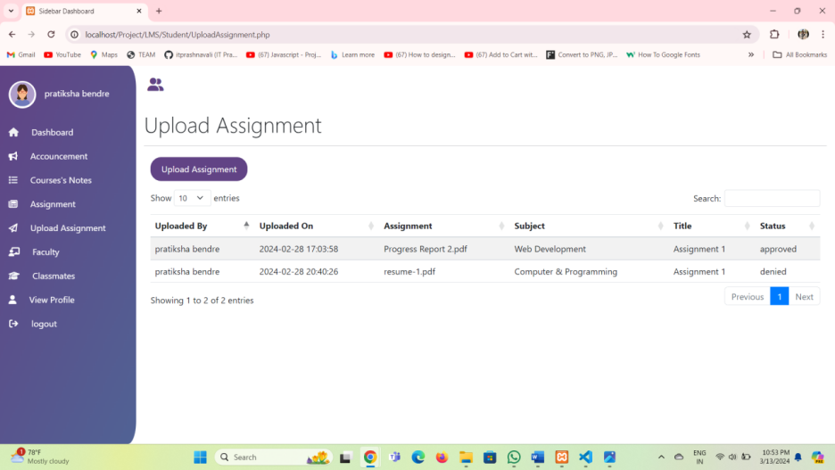
DESIGN REPORT
E-Notes Management System
53

Slide 62
TESTING REPORT
login:
Test Field | Test data | Valid/Invalid | Test result
Username | Null | Invalid | Please enter username
 | 123 | Invalid | Please enter valid username
 | ABC | valid | -
Password | Null | Invalid | Please enter password
 | 323 | Invalid | Please enter alphanumeric
 | 123Abc | valid | -
E-Notes Management System
54

Slide 63
TESTING REPORT
Change password:
Test Field | Test data | Valid/Invalid | Test result
Current Password | Null | Invalid | Please enter username
 | 123 | Invalid | Please enter alphanumeric
 | 123ABC | valid | -
New Password | Null | Invalid | Please enter password
 | 323 | Invalid | Please enter alphanumeric
 | Abc111 | valid | -
E-Notes Management System
55

Slide 64
TESTING REPORT
forgot password:
Test Field | Test data | Valid/Invalid | Test result
New Password | Null | Invalid | Please enter username
 | 321 | Invalid | Please enter alphanumeric
 | Abc112 | valid | -
confirm Password | Null | Invalid | Please enter password
 | 323 | Invalid | Please enter alphanumeric
 | Abc112 | valid | -
E-Notes Management System
56

Slide 65
TESTING REPORT
Add subject:
Test Field | Test data | Valid/Invalid | Test result
Enter subject code | Null | Invalid | Please enter subject code
 | abc | Invalid | Please enter only numeric
 | 112 | valid | -
Enter subject Name | Null | Invalid | Please enter subject name
 | 323 | Invalid | Please enter alphabate
 | ABC | valid | -
Enter subject Name | null | Invalid | Please enter subject short-name
 | abcdexs | Invalid | Please enter length <5
 | Ecc | valid | -
E-Notes Management System
56

Slide 66
TESTING REPORT
Upload Notes:
Test Field | Test data | Valid/Invalid | Test result
Select Subject | null | Invalid | Please select subject
 | IT | valid | -
Choose files | null | Invalid | Please choose file
 |  | valid | -
Select file-type | null | Invalid | Please select file-type
 | zip | Invalid | Select only PDF,docs,mp4
 | PDF | valid | -
E-Notes Management System
56

Slide 67
TESTING REPORT
Upload Assigment:
Test Field | Test data | Valid/Invalid | Test result
Select Subject | null | Invalid | Please select subject
 | IT | valid | -
Choose files | null | Invalid | Please choose file
 |  | valid | -
Select file-type | null | Invalid | Please select file-type
 | docs | Invalid | Select only PDF
 | PDF | valid | -
E-Notes Management System
56

Slide 68
LIMITATION OF SYSTEM
Improvement in GUI and more user friendly interface.
Limited Interaction and Discussion.
It is not a single page application.
It can not share notes with other applications.
E-Notes Management System
57

Slide 69
FUTURE ENHANCEMENT
One can upgrade the performance of report(including more graphical reports);
Backup and Restore facilities can also be included
Doubt session can be added for students by faculty.
Group session can be added for students.
Chat bot can be included.
Live video chat for student and faculty.
Collabrative Sticky Notes.
E-Notes Management System
58

Slide 70
JUSTIFICATION OF MIS
Our system is MIS.
E-Notes Management Site is Management Information System because,
It helps administrator to manage different kinds of information and users.
It helps managing the data easily and also provides information when needed.
MIS is general terms for the computer systems in a organization that assists the administrator of the organization in management oriental task and problem specific task and problem solving.
Retrieval of information is very easy.
E-Notes Management System
59

Slide 71
REFEREENCES
WEBSITES:-
https://youtu.be/mKEQ7TJldN8?si=JeicJ-IDzyXyeQ9p
https://youtu.be/mV0-blkc7Vo?si=Fy_iidymvOoCIGtC
https://www.youtube.com/playlist?list=PL9aWomE7q8lQ4ACcQRR97VnKzlngNKfqM
https://assets.ctfassets.net/nkydfjx48olf/5qFMF3mvitLMahX67i7iOb/028229996c13cbc27a0538f055a41b46/php_cookbook.pdf
https://www.youtube.com/watch?v=aDi0yT133a8
https://www.youtube.com/watch?v=5n-tiNha5kw&list=PLxbVBWjVdAEhkNhgoytzpq_ECtRQpTVY8
https://www.youtube.com/watch?v=H1I2h65UnCA
https://www.youtube.com/watch?v=kWOuUkLtQZw&list=PLArhufGdZokAJAJ7PHVQMqaZDMyN80nLE&index=1
https://www.youtube.com/watch?v=j8XZADXinMY
https://www.youtube.com/watch?v=z0z5p6wo-yQ
https://www.youtube.com/watch?v=UrR8M1ytZF4
BOOKS:-
PHP jQuery Cookbook
The Complete Reference PHP
PHP & MYSQL - Bible
E-Notes Management System
60

